Slide 1
ACNE CLASSIFIER
Koay Xian Cong | Liang Han Sheng | Sum Yin Chuang
Team Anti Acne, Malaysia
https://github.com/yinchuangsum/acne_demo

Slide 2



MEET THE TEAM
Our Brains!
Sum Yin Chuang
Liang Han Sheng
His affable disposition contradicts the sternness he possesses when endeavoring to get the job done.
A prodigy in the A.I. field; able to circumvent any perceived limits with a flicker of his mind.
Koay Xian Cong
An ardent enthusiast striving to shatter the imposed boundaries and norms with a flaming desire churning within.

Slide 3
OUR VISION
Implements Deep Learning Technology to Solve Real World Problems
“Never undermine our capacity to unleash mind-blogging masterpieces which we believe will withstand the test of time”
In a long run, we hope to solve skin care issue in the entire generation by using sophisticated deep learning technological advances. We hope to provide individuals best solution towards acne issues to provide a positive social impact on earth.

Slide 4
PROBLEM STATEMENT
So what are we distressing about?
Acne Status
Acne classification & Solution
Skin diseases are very common and nowadays easy to get remedy from. But, sometimes properly diagnosing these diseases can be quite troublesome due to the stiff hard-to-discriminate symptoms they exhibit. Individuals especially youths are not familiar the level of seriousness of their skin issues. Moreover, individuals do not take the correct and prompt action towards the solution of their acne issues due to the lack of knowledge. The omnipresent issue fortunately is inevitable, however, lacklustre measures and insufficient self-awareness are being practiced by the general public, thus resulting in the exponential increase of individuals having critical acne issues.
Social Distancing
Minimize the needs of seeking assistance
Due to the current Covid-19 pandemic, seeking assistance from dermatologist or undergoing facial treatment is unideal. Individuals should take the responsibility by practicing social distancing and staying at home. By using the acne classifier, individuals can take care of their acne issues themselves as well as saving costs.

Slide 5



MOST COMMON SKIN CONDITION
Statistics of individuals having acne
85%
50%
25%
Teenagers
Adult women
Adult men
Acne usually begins in puberty and affects many adolescents and young adults.
Approximately 85 percent of people between the ages of 12 and 24 experience at least minor acne.
Acne can occur at any stage of life and may continue into one’s 30s and 40s.
Acne percentage increases during pregnancy.
Shaving can sometimes cause folliculitis, a condition that often mimics the appearance of acne.
Source: American Academy of Dermatology Association
https://www.aad.org/media/stats-numbers

Slide 6
OUR OBJECTIVES
To So-Called ‘Definition of Our Entire Project
Acne Classification
01
Classify the level of seriousness of acne.
1
Acne Classifier
Solution
2
3
Acne Monitoring
Provide the best solution. (Proposed)
Data logging for analysis.
03
02

Slide 7
THE IDEA!
Behold the Pioneering of something Truly Extraordinary
We wanted to classify the most common acne issues with different levels of seriousness and provide individuals with best solution that had been tested by others!

Slide 8
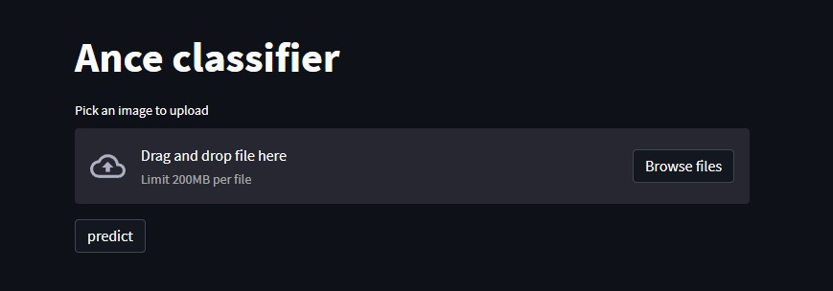
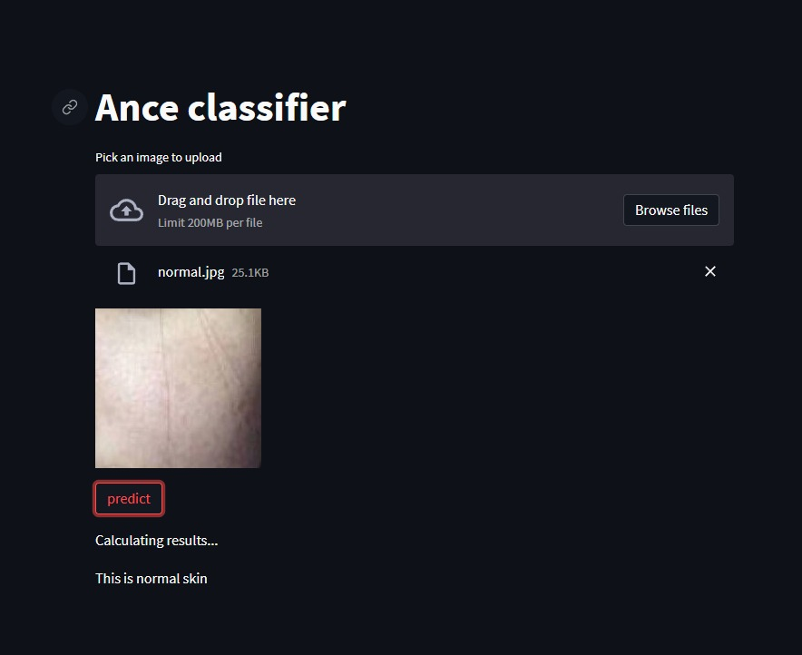
THE SOLUTION
Tackling the Arduous Challenge First-Hand
An Interface for Individuals to Upload Images
Individuals can upload their acne images onto the interface that we developed with acne classifier using deep learning technology where the computer will learn the pattern of acne over time.
Propose the Best Solution to Cure the Acne
By using deep learning technology, we are able to provide individuals with similar classes of acne the best solutions.

Slide 9
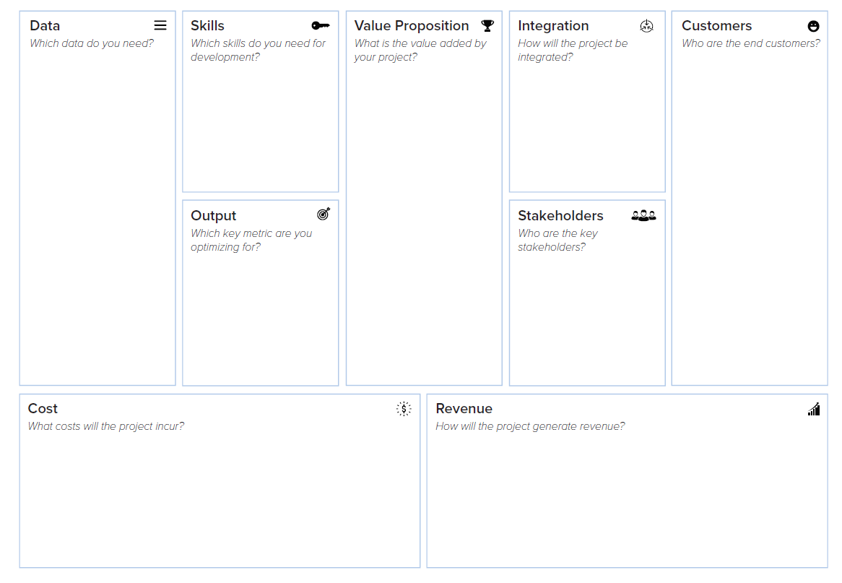
-Transfer learning
- App design
-Researching
Model provide accurate acne classification.
Enable data collection for stakeholder
Collaboration with business partners
-Techno savvy group
- Curious about skin health
- Teenagers
Public Dataset - Kaggle
999 images
JPEG or PNG
With raw dataset 999images expect to achieve 90% accuracy
researchers, skin experts, dermatologist, institution, market survey
Let’s Move On!
Don’t worry. We surely support you.
Current investment- small scale
Hardware compatibility to CPU intel core i7, 16GB RAM, GPU Nvidia GTX1070, HDD 50GB.
Big scale → server/ cloud computing
Marketing - test version, premium version, advertisement.
Product Subscription -> long term profit
Goodwill and loyalty from customer

Slide 10
THE JOURNEY
The Step that Combines the Hard Work
1
2
3
4
5
DATA COLLECTION
ANNOTATION
EVALUATION
DATA PREPROCESSING
ARCHITECTURE & MODELING
First and foremost, each and every images are collected from the internet and checked.
Each and every images are labelled into 4 different classes. The classes are separated through different level of seriousness.
Image augmentation and normalization is carried out to make sure every classes have the same size and dimension of images.
We use Resnet-18 and fine tune the pretrained model.
With endless tuning, we are able to achieve accuracy up to 90.0%.
“Still keep growing up!”

Slide 11
DEMO (Video)

Slide 12
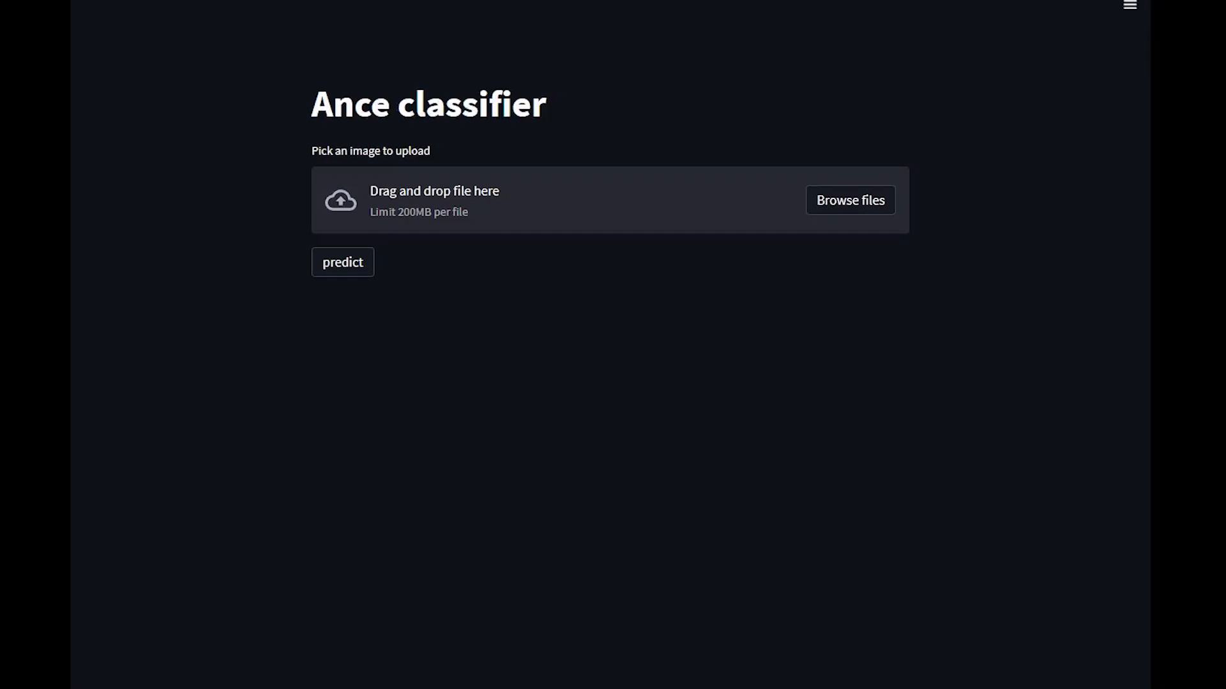

Slide 13
CODE
https://github.com/yinchuangsum/acne_demo

Slide 14

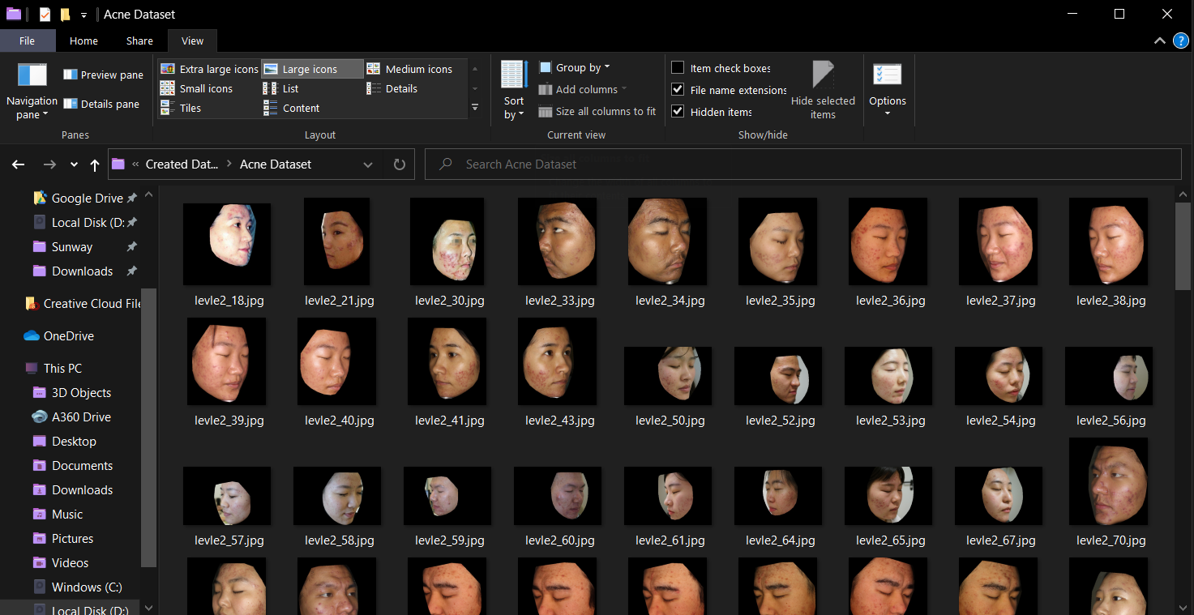
DATA COLLECTION
Acne Classifier
Kaggle
Kaggle, a subsidiary of Google LLC, is an online community of data scientists and machine learning practitioners.
Kaggle allows users to find and publish data sets, explore and build models in a web-based data-science environment, work with other data scientists and machine learning engineers, and enter competitions to solve data science challenges.
Source:https://www.kaggle.com/rutviklathiyateksun/acne-grading-classificationdataset

Slide 15
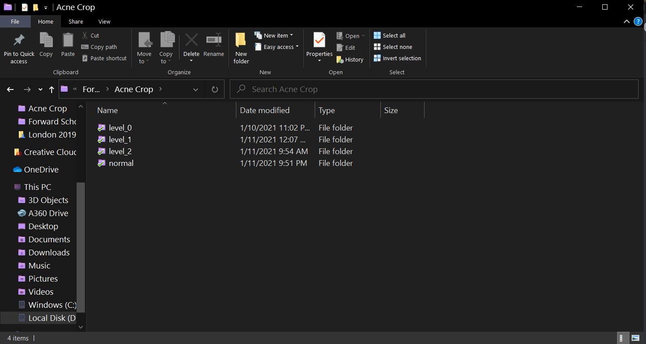
ANNOTATION

Slide 16
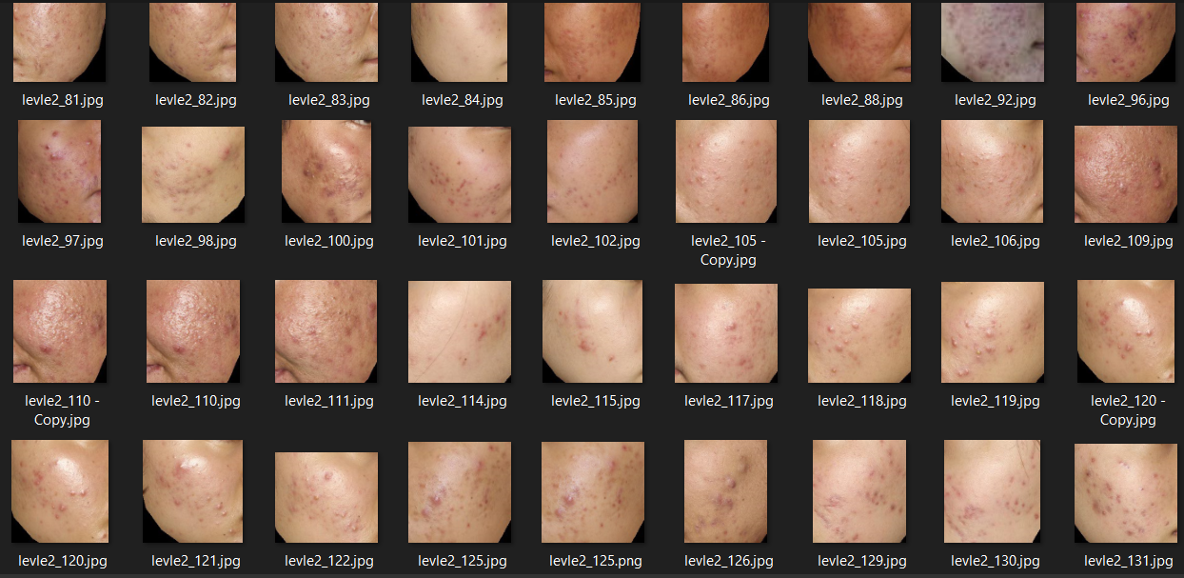
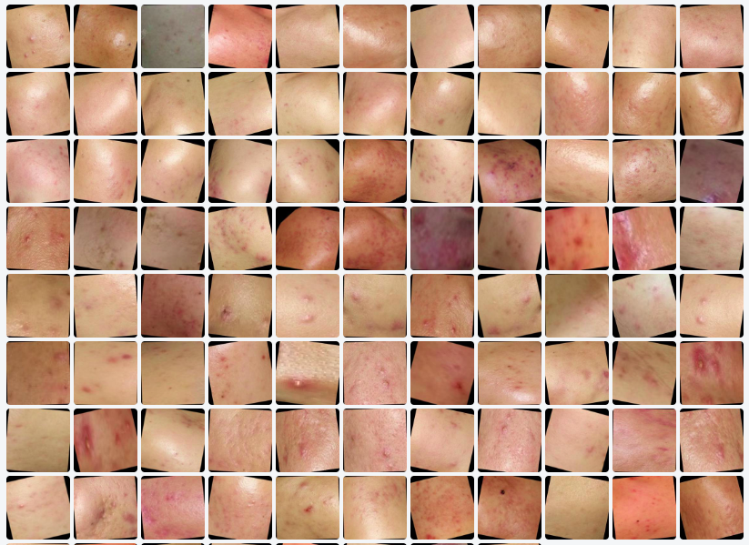
DATA PREPROCESSING
Target Image Cropping Manually to Remove Unwanted Noise (i.e. eyes, nose, mouth)
Flip: Horizontal, Vertical
90° Rotate: Clockwise, Counter-Clockwise, Upside Down
Crop: 0% Minimum Zoom, 50% Maximum Zoom
Rotation: Between -15° and +15°
Blur: Up to 10px
Rotate: 30 degree

Slide 17
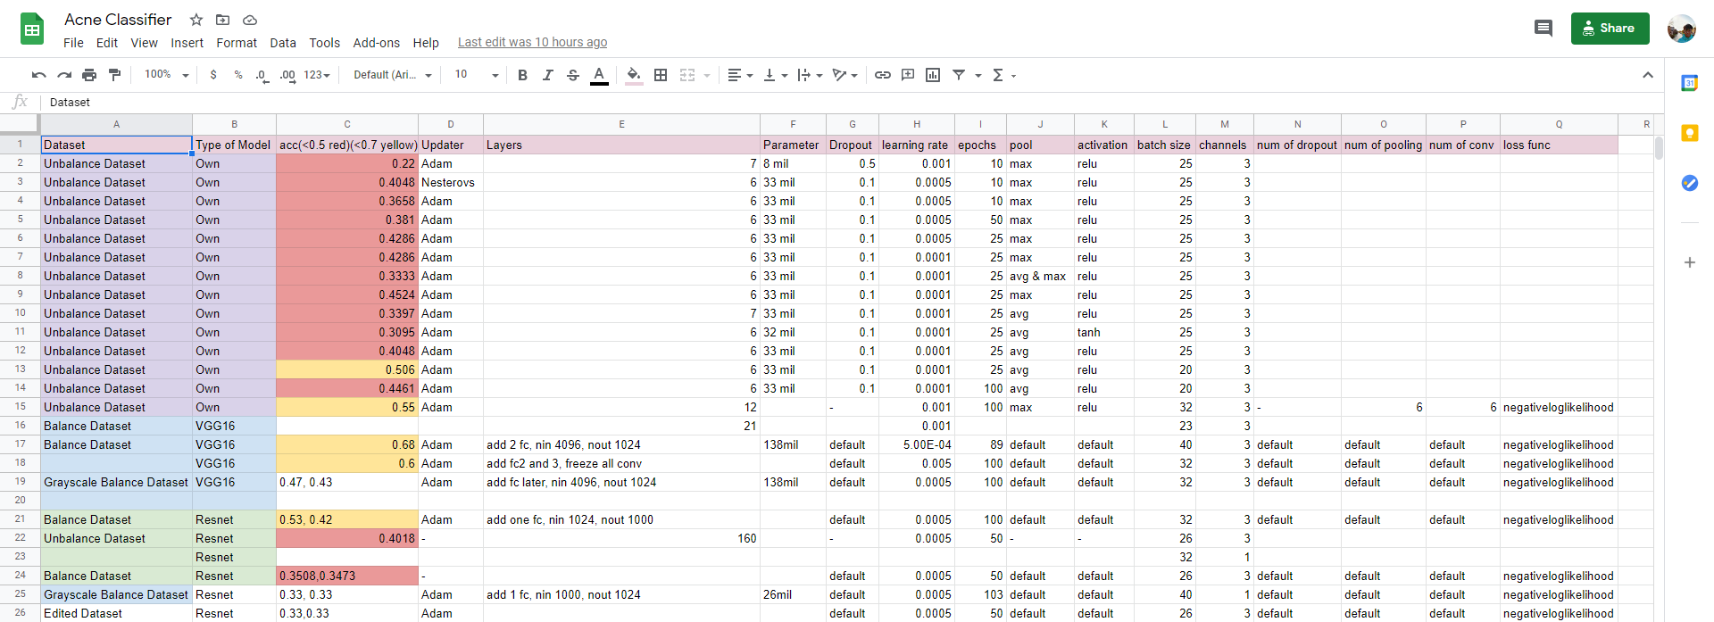
ARCHITECTURE & MODELING
Acne Classifier
We tried to build our own model initially but couldn’t achieve great result. We then tried different architecture and models up to at least 50 times before decided to use Resnet-18. By keeping track of our models, we analyzed that Resnet-32 is the most suitable architecture to be used in this project. We also utilised wandb to fine-tune the weights and bias to achieve maximum accuracy.

Slide 18
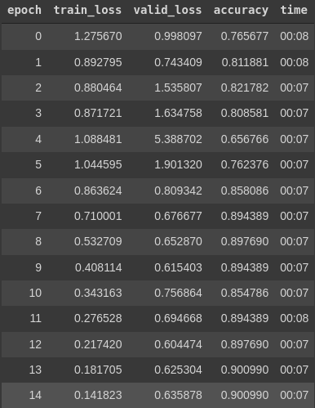
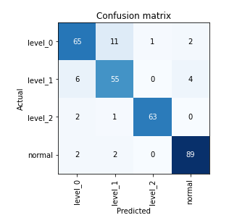
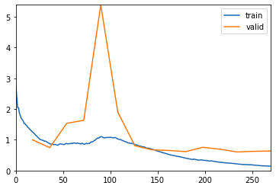
EVALUATION
Acne Classifier
Loss Function
Confusion Matrix
Accuracy
After never-ending training and testing with different models and architecture, we finally achieve the accuracy we wanted which is 90.0%!

Slide 19
Development Blockers
Notes:
Next, I’d like to talk about the problem we faced during the development.

Slide 20
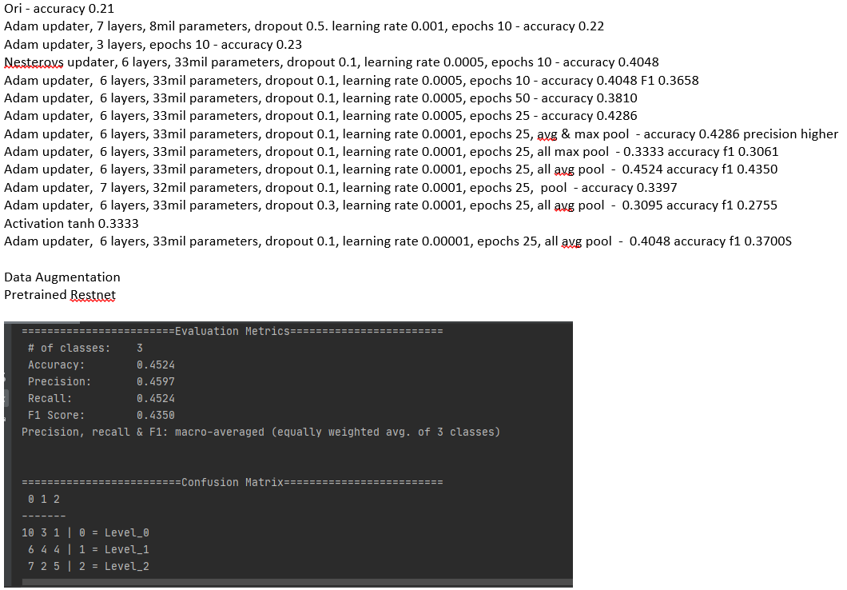
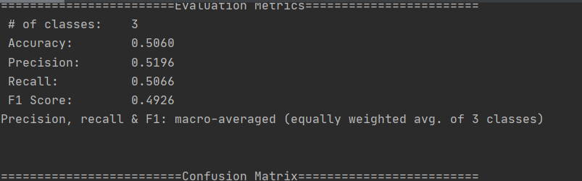
PROBLEM FACED
Underfitting
Using Own Model
Able to Achieve up to 50.6% Accuracy after Tuning for several Weeks

Slide 21
SOLUTION
Use Different Deep Learning Architecture
Using Resnet-18
Able to Achieve 90.00% Accuracy after Fine-Tuning

Slide 22
PROBLEM FACED
Underfitting
High Bias Data
Images contain parts that are not useful

Slide 23
SOLUTION
Image Processing
Crop Acne Area
Remove Unwanted Parts

Slide 24
PROBLEM FACED
Underfitting
High Bias Data
Inconsistent Brightness in Dataset

Slide 25
SOLUTION
Image Processing
Data Augmentation
Pre-processed Data using various Filters

Slide 26
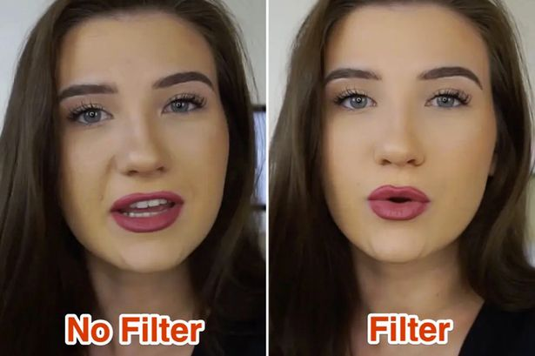
PROBLEM FACED
Filters Applied to Phone Images causes Images Uploaded Pre-processed
False Input
Images Uploaded might be Filtered if taken from Camera App
Source:https://www.mirror.co.uk/tech/youtubers-using-special-cameras-built-21207287

Slide 27
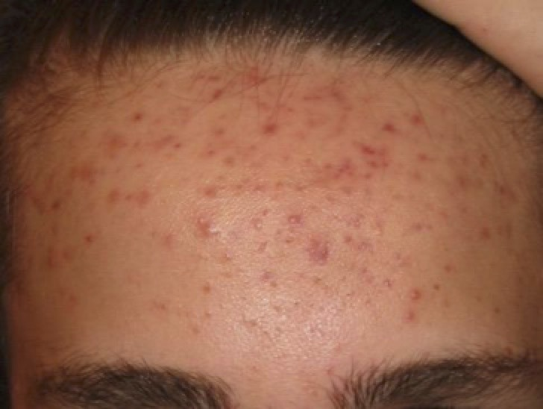
PROBLEM FACED
False Input
Whole face cannot be detected, hence acne grows on other parts of the face needs to be tested twice.
Source:https://www.mirror.co.uk/tech/youtubers-using-special-cameras-built-21207287

Slide 28
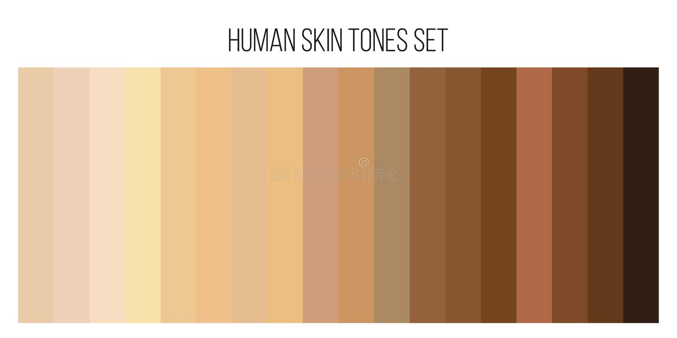
PROBLEM FACED
Various Skin Complexion
Confused Model
Current Model only Trained with Lighter Asian Skin due to limitation of Available Dataset
Source:https://www.dreamstime.com/illustration/human-skin-color.html

Slide 29
COMPARISON TABLES
Comparing the Acne Classifier with Contemporary Alternative Options
ACNE CLASSIFIER
Free
5 Seconds
Follow Up Anytime
Recommends Best Skin Care Solution (Proposed)
24/7 Support
Virtual Interaction
DERMATOLOGY
$221
2 Hours
Appointment Needed
Recommends Best Skin Care Products & Solution
Working Hours Only
Real Life Interaction
FACIAL TREATMENT
$100
1.5 Hours
Appointment Needed
Recommends Skin Care Products to Gain Profits
Working Hours Only
Real Life Interaction
Best Options
With all this glaring and concrete information available, no one can hide from the fact that our Acne Classifier is the most viable option when compared to current plausible alternatives.

Slide 30
POSSIBLE IMPROVEMENTS
Make into a Smartphone App
A Platform to Discuss about Skin Care Products
By developing the Acne Classifier into a smartphone app, individuals can check their acne condition anytime, anywhere! Individuals can take picture with no filters directly from the mobile app.
Individuals who have tried certain skin care products are able to review and give comments or rating through the platform.
Cross geographical samples
More detailed classifier
One of the limitations now is we have limited resources and we can only classify acne for Asians.
Develop the acne classifier to classify detailed acne problems such as blackhead.
Collaboration with Dermatologists
Higher Accuracy
Individuals can contact dermatologists through this platform to know more details about their skin conditions.
Due to lacking resources and computational power, we can only achieve optimum accuracy. However, higher accuracy can be obtained by enhancing our model.

Slide 31
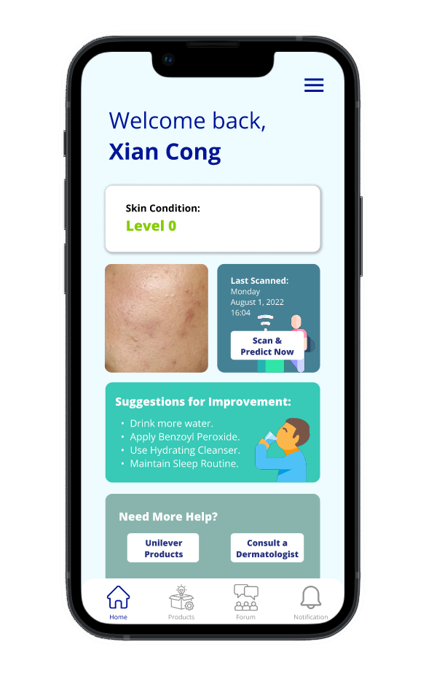
Mobile App Overview

Slide 32
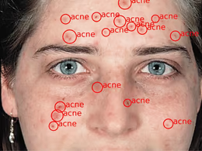
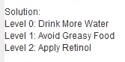
POSSIBLE IMPROVEMENTS
7
Develop an Object Detection Model
Since one of the problems now is that the acne classifier can only detect one part of the face, an object detection model will solve the problem by drawing a bounding box around acne detected on the whole face.
8
Suggestions of Treatments
Once the model detects the level of seriousness of the acne, it is able to provide some basic treatment suggestions before escalating to seek for dermatologist for help.

Slide 33
That’s all. Thank you! ☺

